Slide 1


SKILLABLE IA
Empower talent, break down barriers
Innovation Challenge: AI for supported employment job coach
Improve employment for people with blindness

Slide 2


Did you know?
16 %
75 %
16% of the global population lives with at least one disability (OMS, 2023)
of individuals who are blind are unemployed in Europe and USA (Lentstore and WSBlind, 2021)
2 - 5%
is the quota range for the employment quota for individuals with disabilities in companies,but it is often not fulfilled
43 M
9/10
individuals live with blindness, and 295 million experience moderate to severe visual impairments (OMS, 2023)
employers in 2021 in Europe considered individuals who are blind as nearly impossible to employ (Lentstore)

Slide 3
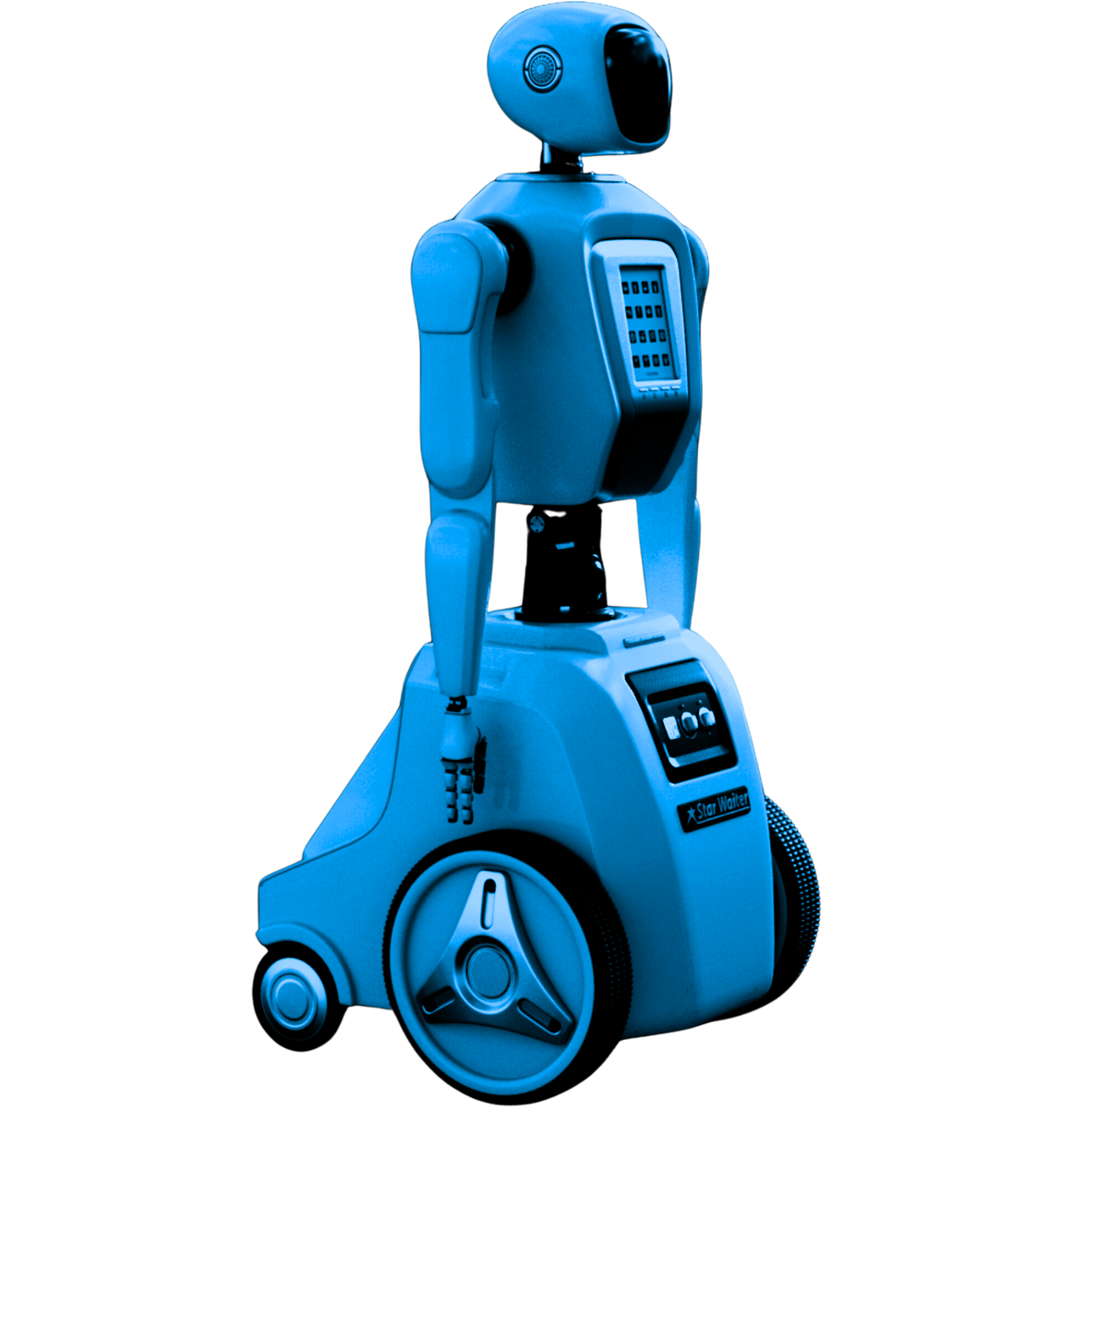
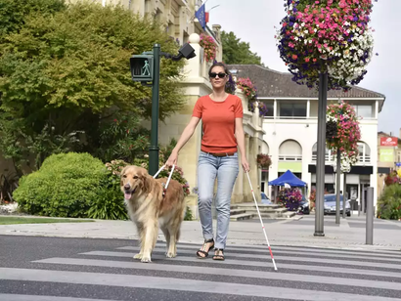

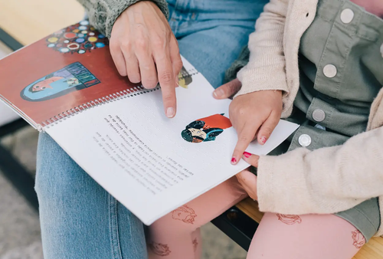


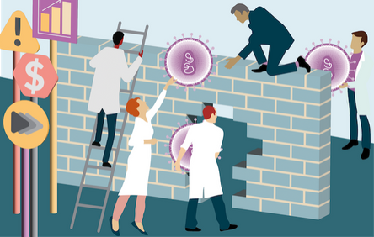
The main challenges:
Lack of accessibility
Job trainers and companies often lack adequate tools and technologies adapted for blind individuals
Lack of inclusive training
Training programs are not always designed for blind individuals, which reduces their opportunities for workplace inclusion
Technological barriers
There is also a lack of technology to help address these challenges

Slide 4
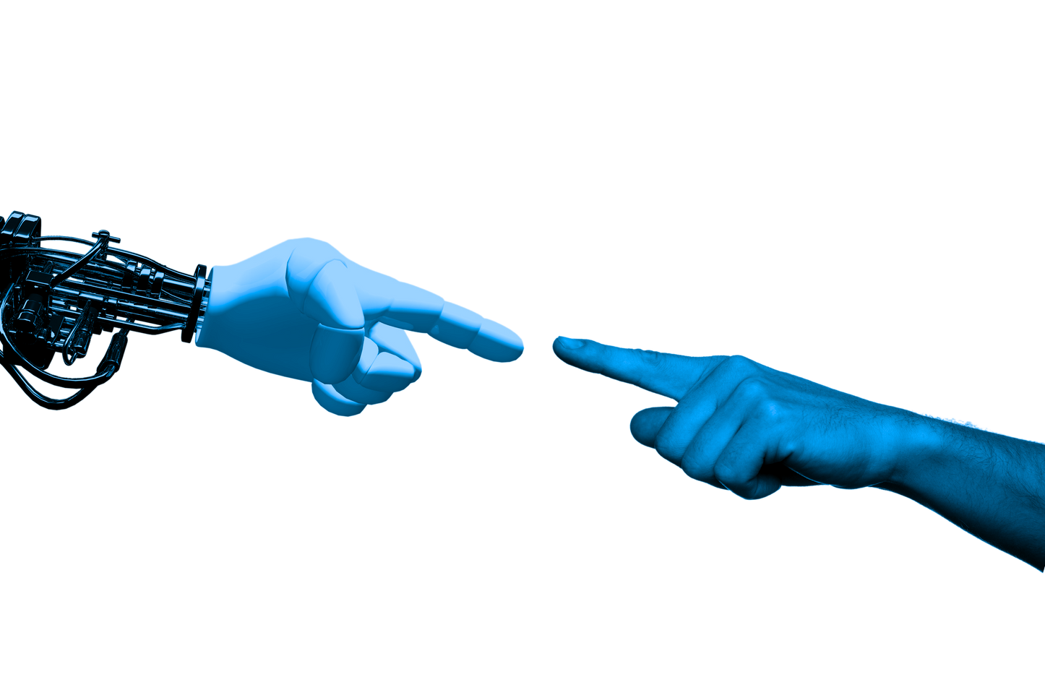





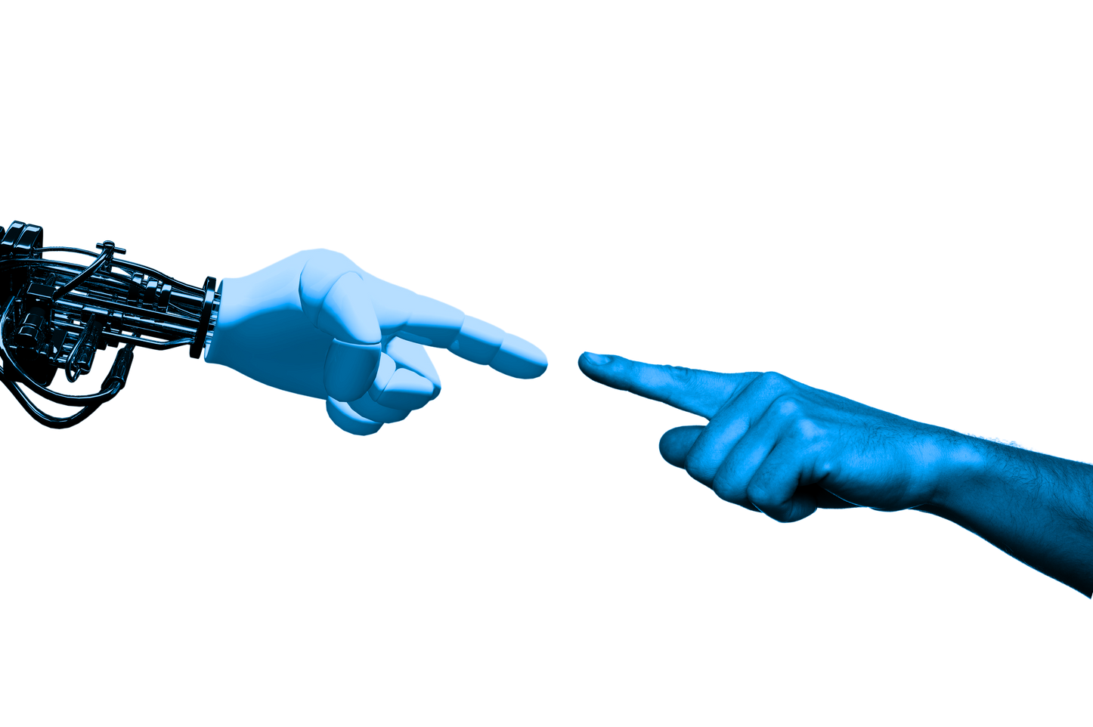
The flow of our solution
In audio format
Ingest training materials
with Azure Document intelligenve, Azure Open AI, Speech Services through Azure Durable Functions
Send communication with Azure communication services
SkillAble IA
In braille format
Chatbot to guide job coaches on how to support individuals with disabilities.

Slide 5
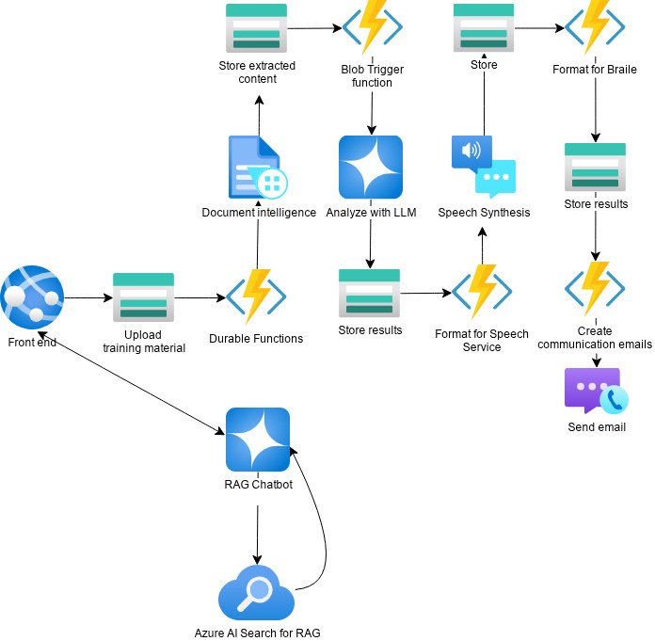
Project Architecture

